Slide 1
Writing Process

Slide 2
The Writing Process
Writing Prompt. What type of paper are you being asked to write?
Read Carefully. Underline facts, opinions, and statements from different sources.
Pre-Write. Graphic Organizer.
Compose. Five paragraph essay format.
Revise/edit. Revise drafts.
Finalize. Write final draft.
Works Cited Page.

Slide 3
Evidence from text
Whether you are writing an expository or persuasive essay, you must use evidence from the text in your essay.
Determine which facts support your claim and thesis.
Strong evidence clearly connects to the question and answer
Underline important facts, quotes, and other information from different sources.
Cite evidence by including quotations of the excerpted text or paraphrase
According to the text…
The author states…
One example from the text is…

Slide 4
Pre-Write
Use a graphic organizer to outline your paper.
Write your Thesis Statement. This will drive the content of your paper.
Determine which claims and facts will be included in which paragraphs.
Informational and persuasive essays will be written a bit differently.

Slide 5
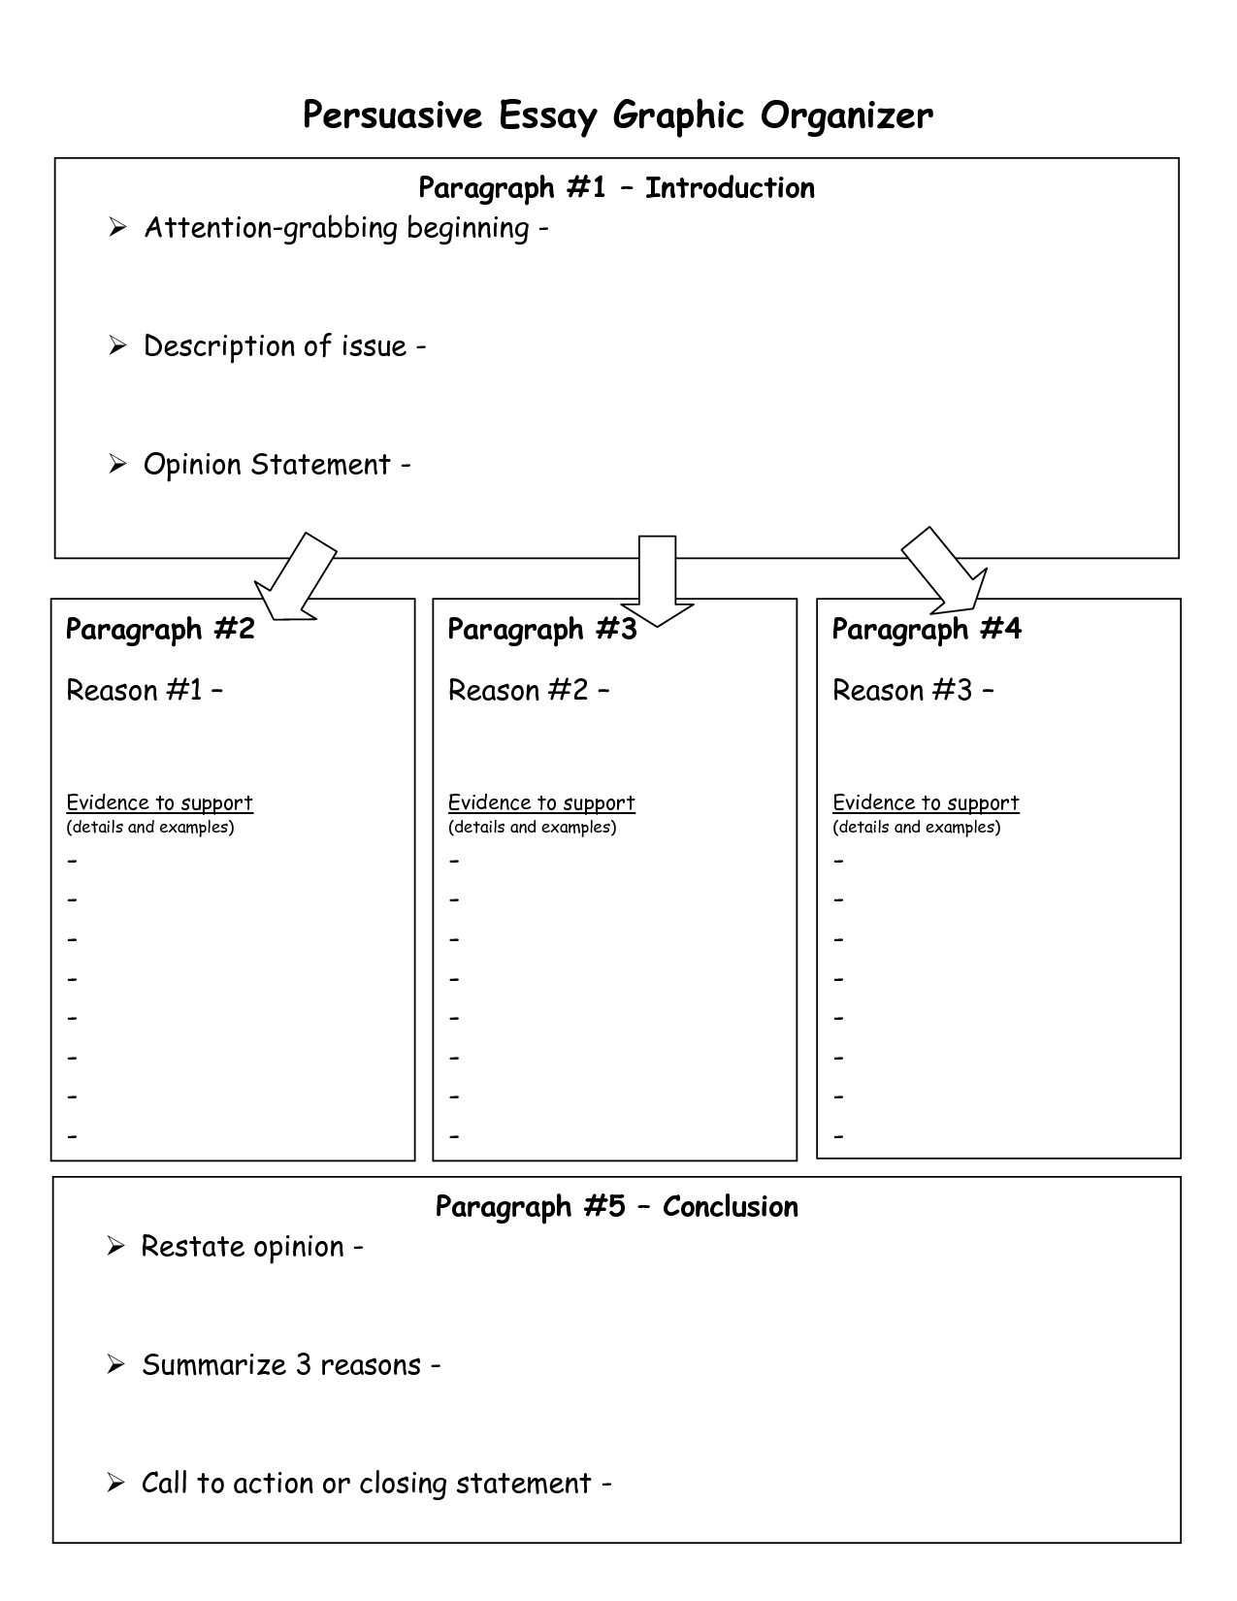
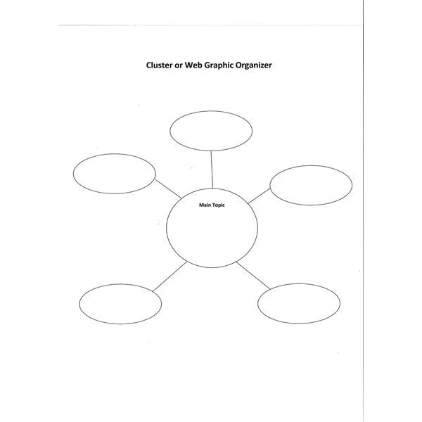

Slide 6
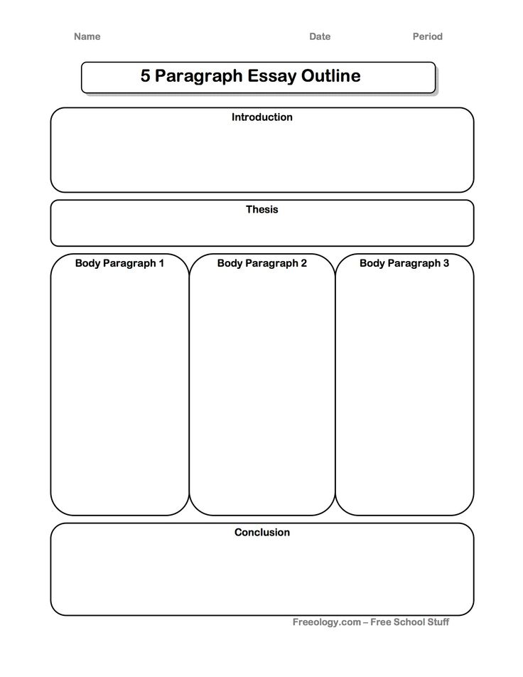
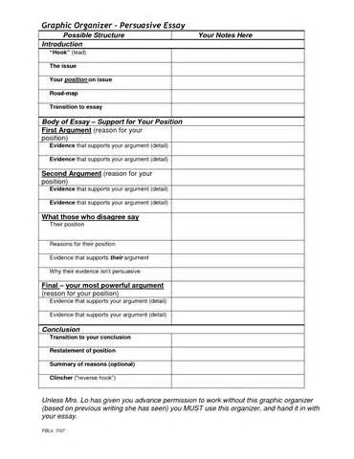

Slide 7
The 5 Paragraph Essay
Paragraph 1
Introduction
Hook. Question, Quote, Onomatopoeia, Statistic, Surprising Fact.
Background
3-4 Sentences
Thesis Statement.
Last sentence in the introductory paragraph. One sentence serves as the organizing principle for the essay.
Informational Example: The life of the typical college student is characterized by time spent studying, attending class, and socializing with peers.
Persuasive Example:. High school graduates should be required to serve two years in the military upon graduation in order to understand other cultures and the globe, develop discipline and respect, and learn a marketable skill.

Slide 8
Introduction Example
Hook
Background
The United States of America is home to over 350 million people, however, only 2.2 million, or less than 1% of the population, serve in the military. The United States of America is, arguably, the most powerful country in the world and its citizens enjoy tremendous freedoms. Yet, most Americans do very little to defend its interests at home and abroad. Instead, they rely on a very small volunteer force to protect the citizens from foreign attack and many young people take their freedom for granted. High school graduates should be required to serve two years in the military upon graduation in order to understand other cultures and the globe, develop discipline and respect, and learn a marketable skill.
Thesis

Slide 9
5 Paragraph Essay
Paragraphs 3-4. Main Points from Thesis
1st Sentence= Topic Sentence. Points from Thesis.
First Sentence in the paragraph
Everything in the paragraph should support the topic sentence.
Include facts from reading/research to support topic sentence
Last Sentence = Transition
Transition to next point/paragraph

Slide 10
Paragraph Example
Serving in the military is an excellent way for young people to understand other cultures and increase their global awareness. According to the Department of Defense, there are approximately 800 U.S. military bases and posts outside the continental United States. The average soldier is assigned to, or serves at, an overseas post for more than half of their enlistment. The U.S. military has established very strong ties and partnerships with countries on every continent. Military personnel stationed at these overseas locations have a unique opportunity to learn about the local cultures and interact with the local populations. These experiences help them to understand the differences and similarities in all people and teach them respect for self and others.

Slide 11
Conclusion
Last paragraph
Summarizes and restates thesis
Reiterates major points
For a persuasive essay, include a “Call to Action.”

Slide 12
Conclusion Example
The U.S. military is a great way for young people to develop many of the skills they will need throughout life while serving their country. They have the opportunity to travel the globe and experience difference countries and cultures. Through these experiences, they gain wisdom, maturity, and respect for self and others while learning discipline and taking pride in a job well done. The military is on the leading edge of technology development and many skills learned while serving are in demand in the civilian job market. The U.S. Congress should pass a bill making it mandatory that all high school graduates serve, at least, two years in the military upon graduation. I urge you to sign a petition and demand that your representative support such a bill. Don’t be one of the 99 percent that does nothing to protect our freedoms.

Slide 13
Editing
Six Writing Traits (Ideas, Organization, Word Choice, Voice, Conventions, Sentence Fluency)
Use Writing Guide
Self Edit and Peer Edit
Don’t always have to look for all six traits.
Concentrate on one at a time.
Always look for conventions.

Slide 14
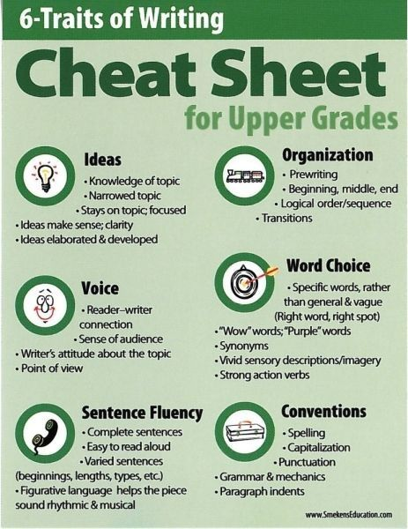

Slide 15
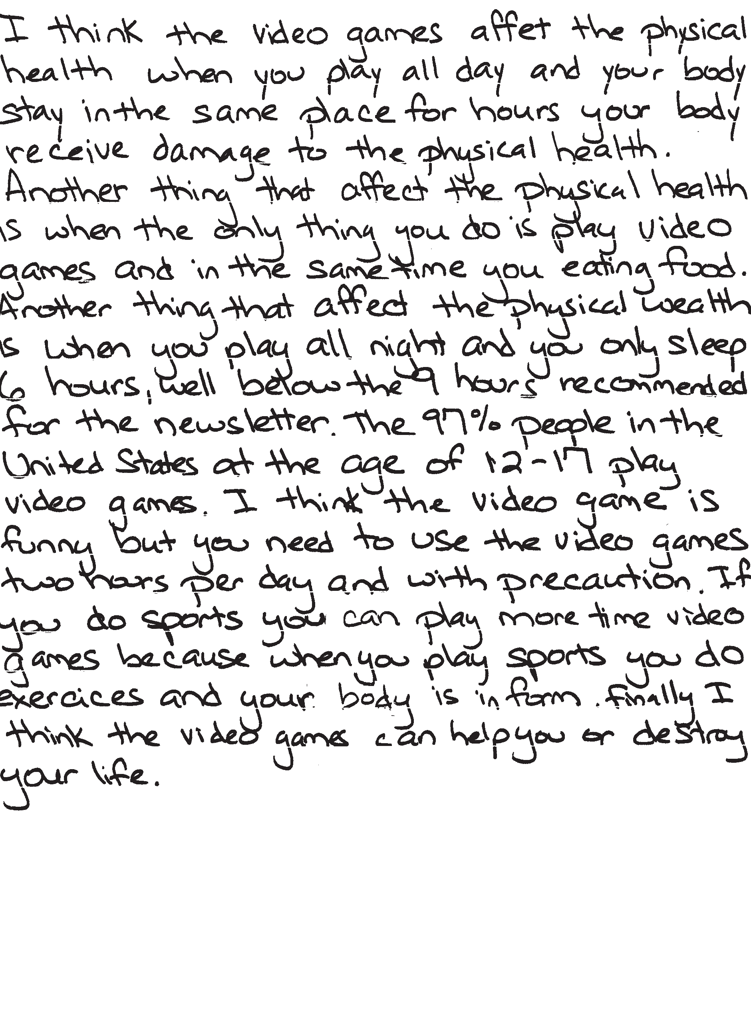
Editing Example

Slide 16
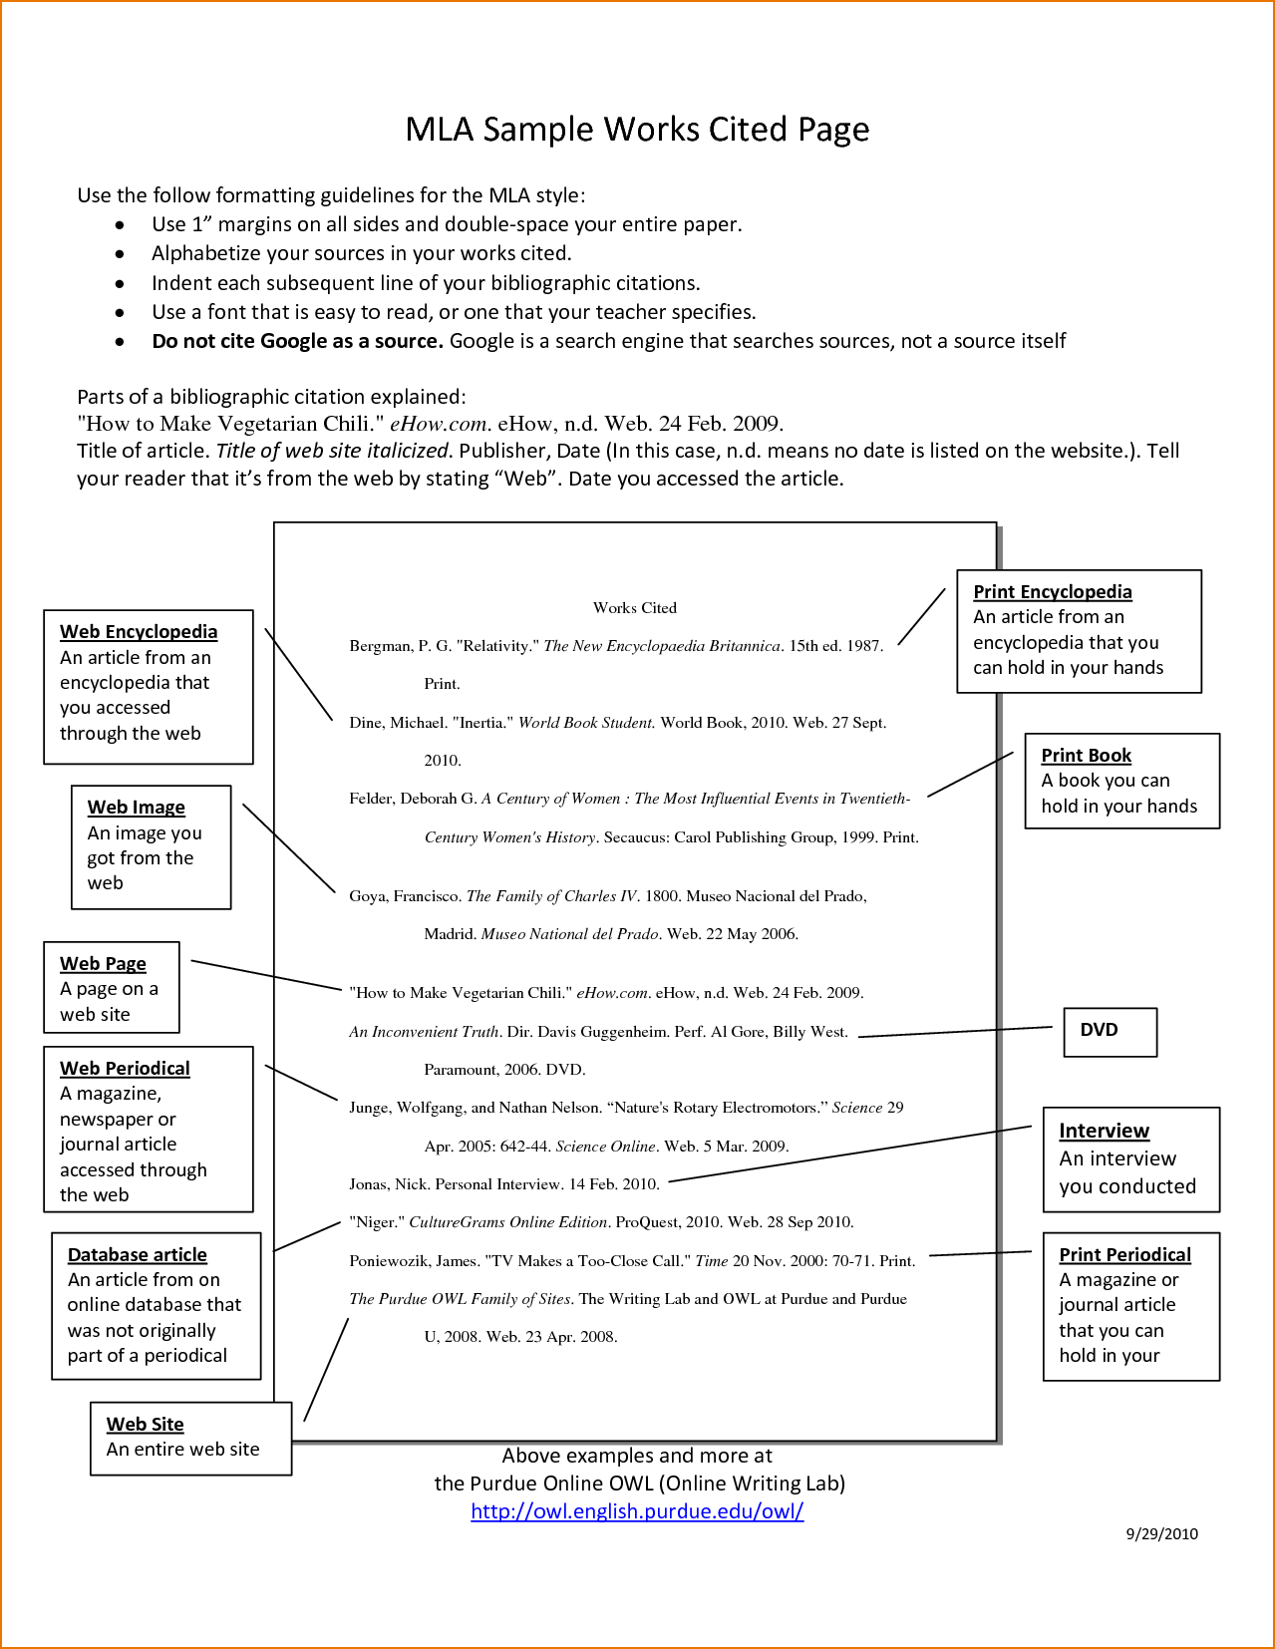
Works cited page
Last, First. “Title”. Website Name. Date.
Website Address. Date retrieved from site.
If something is missing, just omit that part
For Example. No Author. No published date:
“Title”. Website Name.
Website Address. Date retrieved
from site
Alphabetize entries by first letter.

Slide 17
Final Draft
Incorporates all editing changes
Essentially error free
Neatly written or typed
Cover Page
Works Cited Page

Slide 18
References:
Owl.English.purdue/owl/resources/545/01
AZMERIT.gov/assessment/files/2014/05/anindepthlookatwritingtask.org

