Slide 1
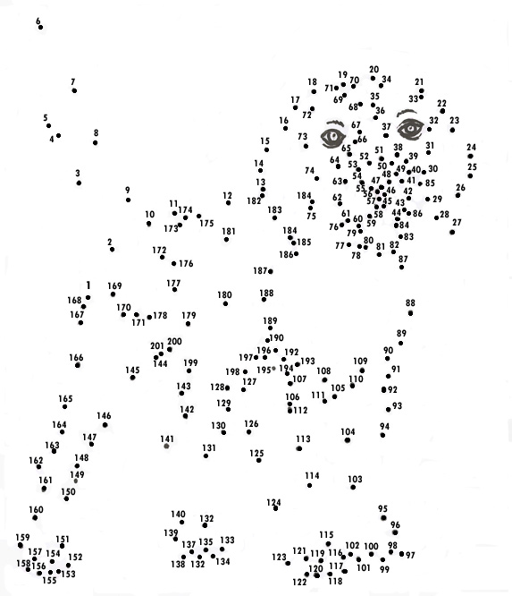
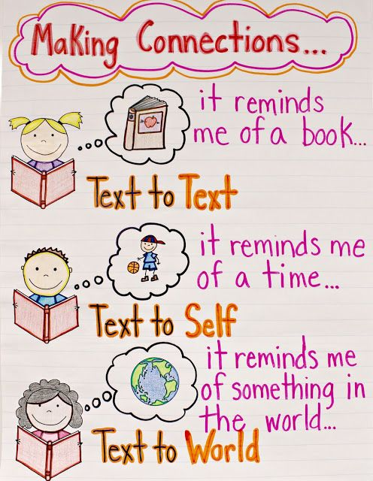
https://www.youtube.com/watch?v=cYPnS6nGLac

Slide 2
Schema is the background knowledge and experience readers bring to the text. Good readers draw on prior knowledge and experience to help them understand what they are reading and are thus able to use that knowledge to make connections.

Slide 3
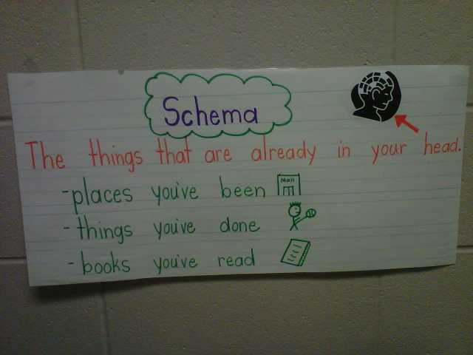
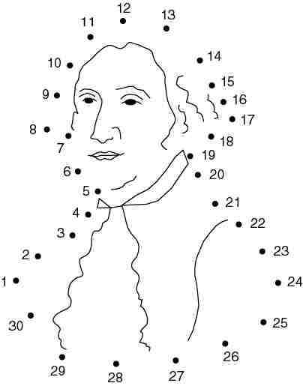
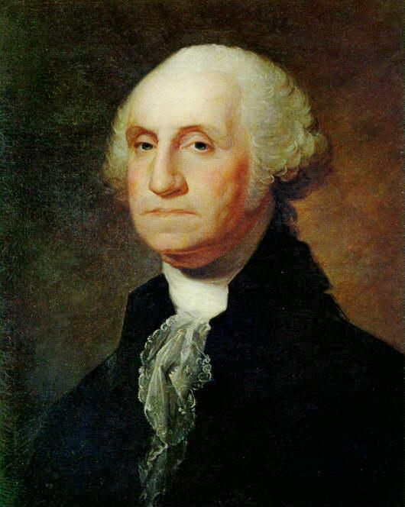
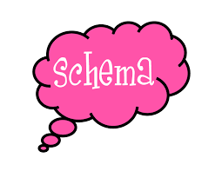
No Schema Schema

Slide 4
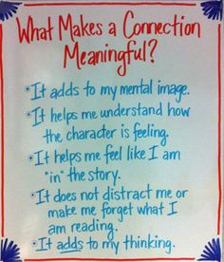

Slide 6
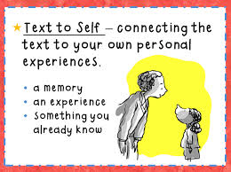
Text-to-Self Connections from the story to your life
What I imagine
My Life
The people I know
How I would feel
The Past
Questions I wonder
My reactions
My Opinions
What I think is important

Slide 7
https://www.youtube.com/watch?v=UXymHkbA5Ng

Slide 8
Text-to-Text How does this story relate to other stories?
How are stories and characters related?
How are stories and characters different?
If these characters met, how would they interact?

Slide 9
https://www.youtube.com/watch?v=O95uVRDALQI

Slide 10
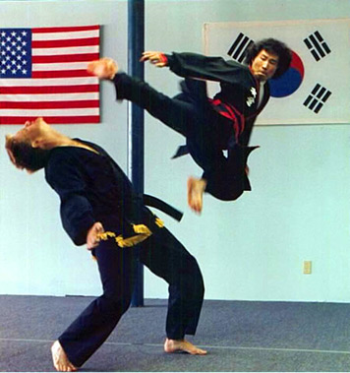
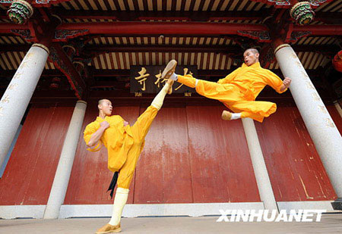
Text-to-World Connecting what you read to the real world
Has anything like this happened in reality?
Where did the inspiration for this story come from?
Could this be from an important event?

Slide 11
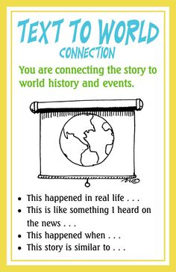
https://www.youtube.com/watch?v=bUeHGhwHRlg

Slide 12
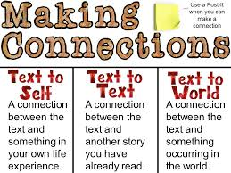

Slide 13
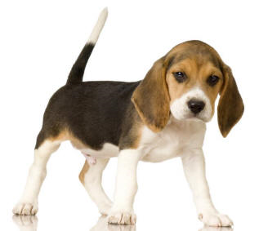
https://www.brainpop.com/health/bodysystems/brain/
Make connections and bring reading to life!

