Slide 1
Main Idea

Slide 2
Main Idea
•What is it?
•How do we find it?
•How do we remember it?

Slide 3
What is main idea?
•Main idea tells what a story is mostly about.
•When looking for main idea we must think of what FINALLY happened in the story.

Slide 4
How do we find the main idea?
•Let’s use our hands!

Slide 5
How do we find the main idea?
•The thumb stands for who.
•The who of a story is very important, without knowing who the story is about we can’t find the main idea.

Slide 6
•The pointer finger stands for did what.
•What did the main character finally do?
•The middle finger stands for where.
•Where did the main character do it?

Slide 7
The ring finger stands for when.
When did the main character do it?
The pinky stands for why.
Why did the main character do it?

Slide 8
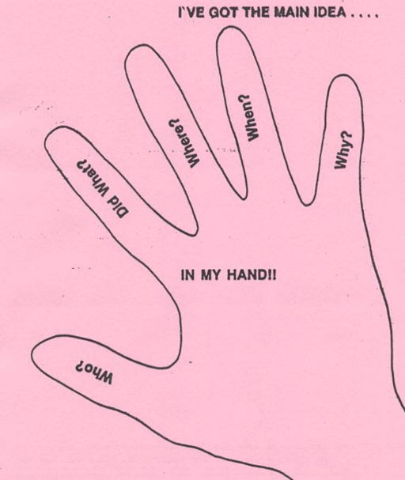

Slide 9
How do we remember main idea?
•Thumb - Who?
•Pointer - Did what?
•Middle finger - Where?
•Ring finger - When?
•Pinky - Why?
•Remembering is easy!!!
•Just look at your fingers.

Slide 10
The focus of a paragraph or an article—what it is all about—is the topic.

Slide 11
The main idea tells you what the story is about.
The main idea maybe the lesson learned or moral of a story.
The main idea is the most important part of a story or paragraph.
The most important thing the author has to say about the topic is the main idea.

Slide 12
Small pieces of information that tell more about the main idea are supporting details.

Slide 13
PRACTICE
Read the Passage and Choose the Main Idea

Slide 14
•Niagara Falls is one of the most beautiful sights in North America. It is on the Niagara River halfway between Lake Ontario and Lake Erie. Niagara Falls is located on the American and Canadian border. The American Falls is 167 feet high. On the Canadian side, the Horseshoe Falls is 161 feet high.

Slide 15
Question
What is the main idea of the passage?
Remember main idea is what the story is about.

Slide 16
Answer
Main Idea: Niagara Falls is one of the most beautiful sights in North America.

Slide 17
•The Statue of Liberty is visited by thousands of people every year. The Statue of Liberty is a 151 foot statue of woman holding a book and a torch. It was a gift of friendship from the people of France. It has become the universal symbol for freedom.

Slide 18
Question
•What is the main idea of this passage?
•What was the passage about?

Slide 19
Answer
Main Idea:
The Statue of Liberty

